Slide 1
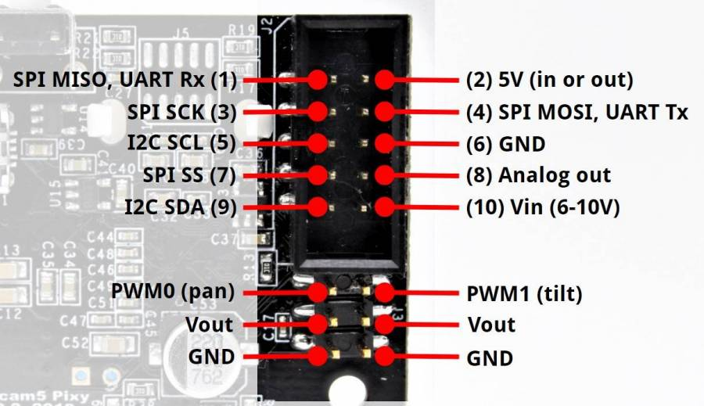
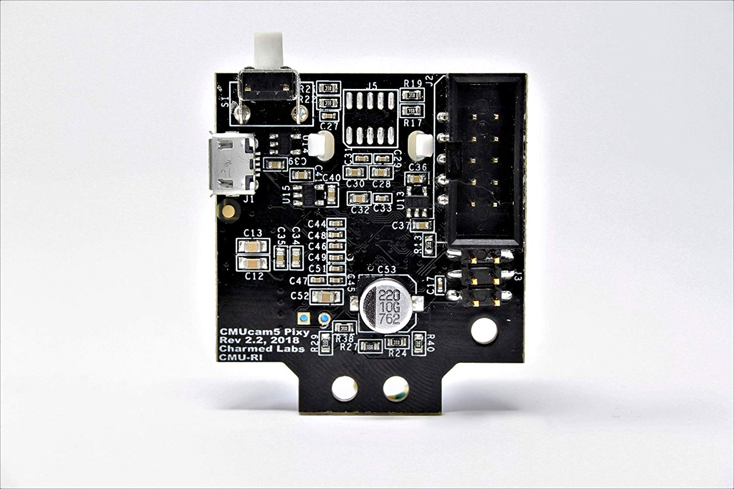
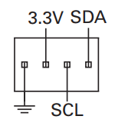
I2C 1
5V
GND
I2C SCL
I2C SDA

Slide 2
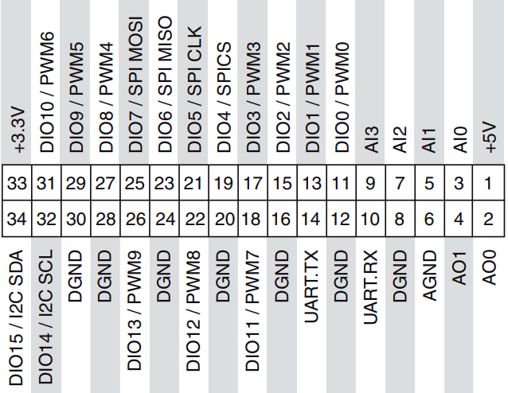
I2C 2
5V
GND
I2C SCL
I2C SDA

Slide 3
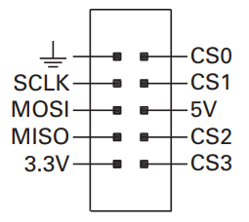
SPI 1
5V
GND
SPI MOSI
SPI MISO
SPI SCK
SPI SS

Slide 4
SPI 2
5V
GND
SPI MOSI
SPI MISO
SPI SCK
SPI SS

Slide 5
UART
5V
GND
UART RX
UART TX

